Slide 1
Capstone Project
Harnessing NLP to Detect Stress
in
Social Media
Early Intervention for Mental Wellbeing Presenter: Jimmy Chong
Notes:
Good morning/afternoon, everyone. My name is Jimmy Chong, and today, I'll be presenting my capstone project titled "Harnessing NLP to Detect Stress in Social Media."

Slide 2
Agenda
Bio
Project Context & Business Problem
Business & Data Science Considerations
Data Overview
Data Exploration
Data Split
Data Overview
Deliver
Summary, Conclusions & Next Steps
Appendix
Notes:
To give you a brief overview, agenda for today includes:
A quick introduction to myself and my background.
A detailed look at the project context and the business problem we're trying to solve.
A discussion of the business and data science considerations that went into this project.
A comprehensive overview of the data we used.
A deep dive into the data exploration process.
A breakdown of how we split the data for training and testing.
A recap of the data overview.
A presentation of the final deliverable.
A summary of our findings, conclusions, and future steps.
And finally, an appendix for any additional information.
I hope this outline provides a clear understanding of what we'll be covering today. Let's get started!

Slide 3
Bio
Solution Architect with experience in software design and project management
Transitioning to Data Science through a Certificate in Data Science/AI from the Institute of Data
Skills: Data analysis, machine learning, project management, programming (Python, C#, VB.NET), databases
Motivation: Leverage technical background and data science skills to solve real-world problems and drive innovation
Key Projects:
Stress Detection: Developing an NLP-based model to detect stress in social media text
Predicting and Understanding Factors that Influence Hotel Booking Cancellations
Predicting West Nile Virus Presence Using Machine Learning
Notes:
I'm currently transitioning into the field of Data Science through a Certificate in Data Science/AI from the Institute of Data.
My skills include data analysis, machine learning, project management, and programming in Python, C#, VB.NET, and databases.
I'm motivated to leverage my technical background and data science skills to solve real-world problems and drive innovation.
Some of my key projects include:
Developing an NLP-based model to detect stress in social media text.
Predicting and understanding factors that influence hotel booking cancellations.
Predicting West Nile Virus presence using machine learning.

Slide 4

Project Context & Business Problem
Industry: NLP and Mental Health
Problem: Detecting stress in social media text
Interest: Growing mental health concerns, potential for early intervention, NLP advancements
Previous Work:
NLP techniques: Sentiment analysis, topic modeling, machine learning
Domains: Twitter, Reddit, general datasets
Key findings: Promising accuracy, varying generalizability and robustness
Limitations: Reliance on labeled datasets, potential for bias
Contribution: Exploring LSTM networks, addressing limitations
Notes:
This project focuses on NLP and mental health. Specifically, aiming to detect stress in social media text.
The growing concern for mental health and the potential for early intervention, combined with advancements in NLP, make this a significant area of interest.
Previous work in this field has explored various NLP techniques, including sentiment analysis, topic modeling, and machine learning. These studies have been conducted on different domains, such as Twitter and Reddit, and have yielded promising results in terms of accuracy.
However, these studies also highlight limitations. They often rely on labeled datasets, which can be challenging to obtain, and there's a potential for bias in the models.
To address these limitations, this project explores the use of LSTM networks. By leveraging their ability to capture long-term dependencies in text, aim to improve the accuracy and generalizability of the model.

Slide 5

Business & Data Science Considerations
Stakeholders: Mental health professionals, social media platforms, technology companies, individuals
Business Question: Can we accurately detect stress in social media text?
Business Value: Early intervention, improved user experience, new market opportunities
Data:
Question: Can we extract effective features for stress prediction?
Required: Social media text, stress labels, metadata
Sourced: Reddit, Twitter, Kaggle
Generation: User-generated content
Future Sourcing: Continued access to APIs, exploring other platforms
Notes:
The stakeholders in this project include mental health professionals, social media platforms, technology companies, and individuals.
The business question trying to answer is: Can we accurately detect stress in social media text?
By addressing this question, hope to achieve early intervention, improve user experience, and identify new market opportunities.
In terms of data, need to determine if can extract effective features for stress prediction. This will require social media text, stress labels, and metadata.
The data will be sourced from Reddit, Twitter, and Kaggle. It's important to note that this data is user-generated content.
For future sourcing, need to maintain access to APIs and explore other potential platforms.
By considering these business and data science factors, can ensure the success of project in detecting stress in social media text.

Slide 6

Data Overview (1)
Stress Detection from Social Media Articles
Source: Kaggle Dataset
Objective: Develop a more accurate and efficient NLP-based approach to automatically detect stress in social media text, enabling early intervention and improved mental health support.
Notes:
The dataset was sourced from Kaggle.
The objective of this project is to develop a more accurate and efficient NLP-based approach to automatically detect stress in social media text. This will enable early intervention and improved mental health support.
In the following slides, I'll provide more details about the dataset, including its characteristics and how it will be used in the analysis.

Slide 7

Data Overview (2)
Stress Detection from Social Media Articles
Datasets:
Constructed four datasets using text articles from Reddit and Twitter.
Each article is labeled with a class value of '0' (Stress Negative) or '1' (Stress Positive).
Dataset Descriptions:
Reddit Combi: This dataset combines title and body text from stress and non-stress related subreddits.
Reddit Title: This dataset consists of titles from stress and non-stress related subreddits.
Twitter Full: This dataset contains stress and non-stress related tweets.
Twitter Non-Advert: This dataset is a denoised version of Twitter Full, removing potential advertisements.
Notes:
Four datasets were created using text articles from Reddit and Twitter.
Each article is labeled with a class value of '0' (Stress Negative) or '1' (Stress Positive).
The Reddit Combi dataset combines the title and body text from stress and non-stress related subreddits.
The Reddit Title dataset consists of titles from stress and non-stress related subreddits.
The Twitter Full dataset contains stress and non-stress related tweets.
The Twitter Non-Advert dataset is a denoised version of Twitter Full, removing potential advertisements.
These datasets will be used to train and evaluate our model for stress detection.

Slide 8

Data Exploration (1)
Understanding the Data
Explored the data using Python libraries like pandas to understand the number of rows, column names, and data types.
Examined the first few rows of each Data Frame to get a sense of the content and labels.
Checked for missing values and handled them by dropping rows with missing entries (dropna).
Preprocessed the data:
Dropped unnecessary columns (Reddit Combi).
Cleaned hashtags in Twitter data using regular expressions.
Concatenated all preprocessed Data Frames into a single one.
Analyzed the data distribution:
Visualized the distribution of stress labels using a bar chart.
Examined the distribution of text length for stress and non-stress articles using a histogram.
Generated word clouds to visualize frequently used words in stress and non-stress articles.
Notes:
First, I explored the data using Python libraries like pandas to understand the number of rows, column names, and data types.
Then, I examined the first few rows of each Data Frame to get a sense of the content and labels.
Next, I checked for missing values and handled them by dropping rows with missing entries.
Finally, I preprocessed the data by:
Dropping unnecessary columns from the Reddit Combi dataset.
Cleaning hashtags in the Twitter data using regular expressions.
Concatenating all the preprocessed Data Frames into a single one.
To analyze the data distribution, I visualized the distribution of stress labels using a bar chart.
I also examined the distribution of text length for stress and non-stress articles using a histogram.
Finally, I generated word clouds to visualize frequently used words in stress and non-stress articles.
This data exploration provided valuable insights into the characteristics of our dataset, which will inform the subsequent steps of our project.

Slide 9

Data Exploration (2)
Understanding the Data
Number of Rows and Columns:
Reddit Combi: 3123 rows, 4 columns
Reddit Title: 5556 rows, 2 columns
Twitter Full: 8900 rows, 3 columns
Twitter Non-Advert: 2051 rows, 2 columns
Data Types:
title: object (text)
label: int64/boolean (stress label)
body: object (text) (only in Reddit Combi)
hashtags: object (text) (only in Twitter Full)
Missing Values:
Handled missing values by dropping rows with missing entries in body column.
Data Preprocessing:
Dropped unnecessary columns in Reddit Combi.
Cleaned hashtags in Twitter Full using regular expressions.
Concatenated all datasets into a single DataFrame.
Notes:
Number of Rows and Columns:
Reddit Combi: 3123 rows, 4 columns
Reddit Title: 5556 rows, 2 columns
Twitter Full: 8900 rows, 3 columns
Twitter Non-Advert: 2051 rows, 2 columns
Data Types:
title: object (text)
label: int64/boolean (stress label)
body: object (text) (only in Reddit Combi)
hashtags: object (text) (only in Twitter Full)
Missing Values:
Handled missing values by dropping rows with missing entries in the body column.
Data Preprocessing:
Dropped unnecessary columns in Reddit Combi.
Cleaned hashtags in Twitter Full using regular expressions.
Concatenated all datasets into a single DataFrame.
This information provides a clearer understanding of the data im working with and how it was prepared for analysis.

Slide 10
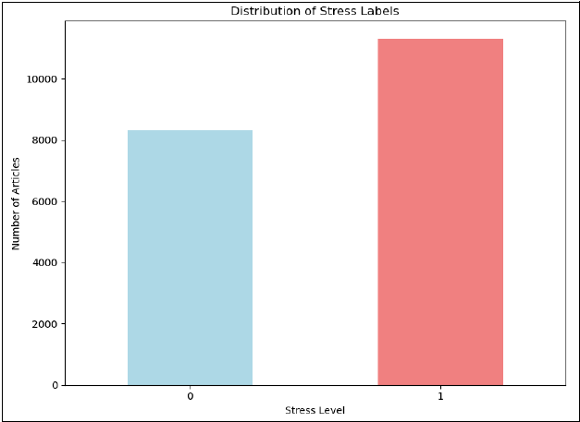
Data Exploration (3)
Frequency of Stressful and Non-Stressful Posts
Key Notes:
Class imbalance: More non-stressful articles than stressful ones.
Impact on modeling: Require techniques like class weighting or oversampling.
Further investigation: Explore factors contributing to imbalance (e.g., labeling difficulty, data collection bias).
Notes:
As you can see in this bar chart, there's a class imbalance in the dataset. There are more non-stressful articles than stressful ones.
This class imbalance can impact modeling and may require techniques like class weighting or oversampling to address.
For further investigation, it's important to explore the factors contributing to this imbalance. This could include labeling difficulty or data collection bias.
Understanding the class imbalance will help us develop a more effective model for stress detection.

Slide 11
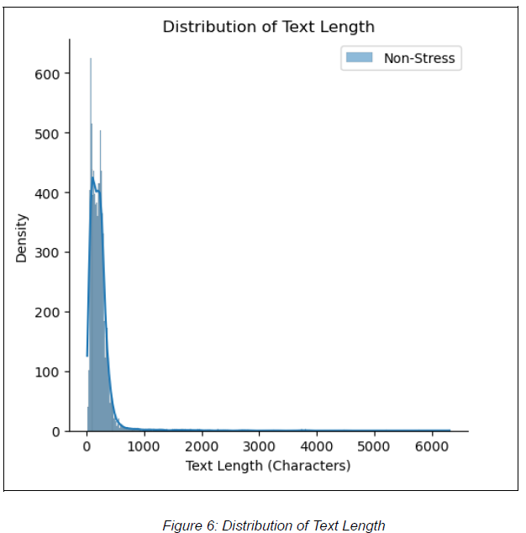
Data Exploration (4)
Distribution of Text Length
Key Notes:
Skewed distribution: Most posts are relatively short.
Overlapping distributions: Text length alone may not be a strong predictor.
Non-stressful posts: Slightly longer on average
Notes:
As you can see in this histogram, the distribution of text length is skewed for both stress and non-stress posts, with most posts being relatively short.
Additionally, the distributions overlap, suggesting that text length alone may not be a strong predictor of stress.
However, that non-stressful posts are slightly longer on average compared to stressful ones.

Slide 12
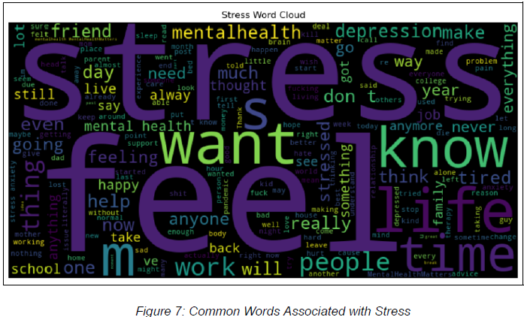
Data Exploration (5)
Common Words Associated with Stress
Key Notes:
Negative emotions: "stress," "depressed," "sad," "anxious"
Life challenges: "work," "school," "relationships," "personal problems"
Seeking help: "help," "support," "therapy"
Notes:
As you can see in this word cloud:
Negative emotions: Words like "stress," "depressed," "sad," and "anxious" are frequently used.
Life challenges: Terms like "work," "school," "relationships," and "personal problems" are common.
Seeking help: Words such as "help," "support," and "therapy" indicate that individuals are seeking assistance.
These findings provide valuable insights into the language used by individuals experiencing stress and can inform the development of stress detection model.

Slide 13
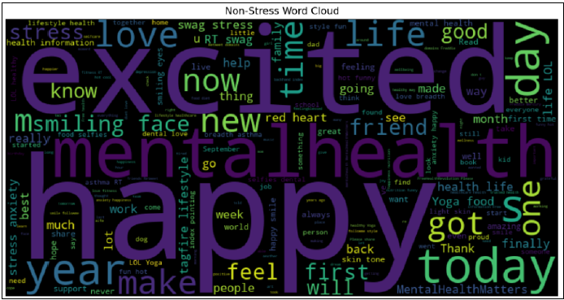
Data Exploration (6)
Common Words Associated with Non-Stress
Key Notes:
Positive emotions: "happy," "love," "good," "excited"
Everyday life: "daily activities," "hobbies," "social interactions"
Gratitude and appreciation: "thankful," "grateful," "proud"
Notes:
As you can see in this word cloud, several key themes emerge:
Positive emotions: Words like "happy," "love," "good," and "excited" are frequently used.
Everyday life: Terms like "daily activities," "hobbies," and "social interactions" are common.
Gratitude and appreciation: Words such as "thankful," "grateful," and "proud" are frequently mentioned.
These findings provide valuable insights into the language used by individuals who are not experiencing stress. By comparing these findings with the words associated with stress, we can better understand the words that tell the difference between these two feeling.

Slide 14

Data Split
Data Preparation for Modeling
Split data into features (title) and target (stress label).
Split data into training (80%) and testing (20%) sets.
Notes:
First, I split the data into features and the target label. The features are the titles of the posts, while the target is the stress label.
Next, I divided the data into training and testing sets. This is a common practice in machine learning to evaluate the model's performance on unseen data.
I allocated 80% of the data for training and 20% for testing. This split allows the model to learn from a larger portion of the data while reserving a portion for evaluation.

Slide 15

Data Overview
Key Findings:
Class imbalance: More non-stressful articles than stressful ones.
Overlapping text length distributions: Text length alone may not be a strong predictor of stress.
Distinct word patterns: Different words are frequently used in stress and non-stress articles.
Notes:
Class Imbalance: There are more non-stressful articles than stressful ones in our dataset. This imbalance can affect model performance and may require adjustments.
Overlapping Text Length Distributions: Text length alone may not be a strong predictor of stress, as the distributions overlap between stress and non-stress articles.
Distinct Word Patterns: Different words are frequently used in stress and non-stress articles. This suggests that analyzing word patterns can provide valuable insights for stress detection.

Slide 16

Deliver (1)
Feature Engineering
Key Features:
Text data (primary feature)
Captures sentiment, emotions, and vocabulary
Business Significance:
Text features are crucial for understanding the linguistic cues associated with stress.
Effective feature engineering can improve model performance and interpretability.
Techniques:
Text Cleaning:
Removes irrelevant information (punctuation, stop words, hashtags).
Text Normalization:
Lowercases text for consistency.
TF-IDF Vectorization:
Converts text into numerical features representing word importance.
Notes:
The primary feature used in this model is the text data itself. This text captures sentiment, emotions, and vocabulary, which are crucial for understanding the linguistic cues associated with stress.
Effective feature engineering is essential for improving model performance and interpretability. By carefully selecting and transforming the text data, we can extract meaningful features that help the model better understand and predict stress.
The techniques used in feature engineering include:
Text Cleaning: Removing irrelevant information like punctuation, stop words, and hashtags.
Text Normalization: Lowercasing the text for consistency.
TF-IDF Vectorization: Converting the text into numerical features that represent the importance of each word in the document.
By applying these techniques, we can create a feature-rich dataset that is well-suited for training our stress detection model.

Slide 17

Deliver (2)
Machine Models Used
LinearSVC: This is a linear support vector classifier used in the initial model. It is a good choice for text classification tasks due to its simplicity and efficiency.
LSTM (Long Short-Term Memory): This is a recurrent neural network architecture used in the later model. LSTMs are well-suited for sequential data like text, as they can capture long-term dependencies between words.
Notes:
LinearSVC: This is a simple linear support vector classifier that was used in the initial model. It's a good choice for text classification tasks due to its efficiency.
LSTM (Long Short-Term Memory): This is a more complex recurrent neural network architecture that was used in the later model. LSTMs are well-suited for sequential data like text, as they can capture long-term dependencies between words.
By experimenting with different models, we were able to identify the most effective approach for detecting stress in social media text.

Slide 18

Deliver - LinearSVC (3)
Evaluation Metrics
Accuracy: Measures the proportion of correct predictions made by the model.
Confusion Matrix: Visualizes the number of correct and incorrect predictions for each class (stressful vs. non-stressful).
Classification Report: Provides detailed information about the model's performance, including precision, recall, and F1-score for each class.
ROC AUC Score: This metric is used for imbalanced datasets and measures the model's ability to distinguish between classes (AUC-ROC score closer to 1 indicates better performance).
Notes:
Here the evaluation metrics used to assess the performance of the LinearSVC model.
Accuracy: This measures the overall proportion of correct predictions made by the model.
Confusion Matrix: This visualizes the number of correct and incorrect predictions for each class (stressful vs. non-stressful). It helps us understand the model's strengths and weaknesses in classifying each class.
Classification Report: This provides detailed information about the model's performance, including precision, recall, and F1-score for each class.
Precision measures the proportion of correct positive predictions.
Recall measures the proportion of actual positive cases that were correctly identified.
F1-score is the harmonic mean of precision and recall, providing a balanced measure of performance.
ROC AUC Score: This metric is used for imbalanced datasets like ours. It measures the model's ability to distinguish between the two classes. An AUC-ROC score closer to 1 indicates better performance.
By using these evaluation metrics, we can comprehensively assess the performance of the LinearSVC model and identify areas for improvement.

Slide 19
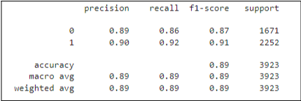
Deliver - LinearSVC (5)
Evaluation Metrics - Confusion Matrix
This confusion matrix visualizes the performance of the LinearSVC model in classifying stress and non-stress posts.
Key Findings:
Accuracy: 89% of samples were correctly classified.
Class-wise Performance:
Stress: Precision: 0.90, Recall: 0.92, F1-score: 0.91
Non-Stress: Precision: 0.88, Recall: 0.85, F1-score: 0.87
Implications:
Overall good performance: 89% accuracy.
Class imbalance impact: Model might be biased towards predicting non-stressful posts.
Notes:
This confusion matrix visualizes the performance of the model in classifying stress and non-stress posts.
Key Findings:
Overall Accuracy: 89% of samples were correctly classified, indicating good overall performance.
Class-wise Performance:
Stress: The model achieved a precision of 0.90, recall of 0.92, and F1-score of 0.91, demonstrating strong performance in detecting stress.
Non-Stress: The model achieved a precision of 0.88, recall of 0.85, and F1-score of 0.87, indicating good performance in detecting non-stress.
Implications:
The overall good performance of 89% accuracy suggests that the LinearSVC model is effective in detecting stress in social media text.
However, the class imbalance may be impacting the model's performance, potentially leading to a bias towards predicting non-stressful posts.
By analyzing this confusion matrix, we gain a better understanding of the model's strengths and weaknesses, which can inform further improvements.

Slide 20
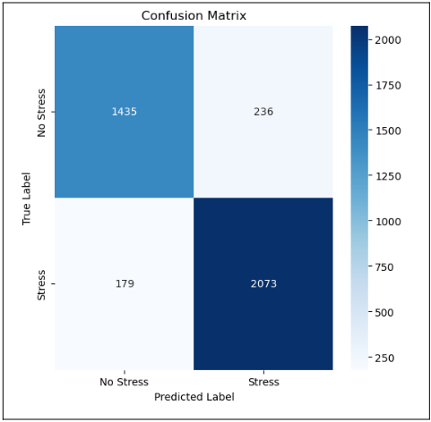
Deliver - LinearSVC (6)
Evaluation Metrics - Classification Report
This classification report summarizes the performance of the LinearSVC model on the test dataset.
Key Findings:
Overall Accuracy: 89%
Class-wise Performance:
Stress: Precision: 0.90, Recall: 0.92, F1-score: 0.91
Non-Stress: Precision: 0.88, Recall: 0.85, F1-score: 0.87
Implications:
Strong overall performance.
Potential impact of class imbalance.
Notes:
This classification report summarizes the performance of the model on the test dataset.
Key Findings:
Overall Accuracy: 89% of samples were correctly classified, indicating strong overall performance.
Class-wise Performance:
Stress: The model achieved a precision of 0.90, recall of 0.92, and F1-score of 0.91, demonstrating excellent performance in detecting stress.
Non-Stress: The model achieved a precision of 0.88, recall of 0.85, and F1-score of 0.87, indicating good performance in detecting non-stress.
Implications:
The strong overall performance suggests that the LinearSVC model is effective in detecting stress in social media text.
However, the class imbalance may be impacting the model's performance, potentially leading to a bias towards predicting non-stressful posts.
By analyzing this classification report, we gain a comprehensive understanding of the model's performance and can identify areas for improvement, such as addressing the class imbalance.

Slide 21
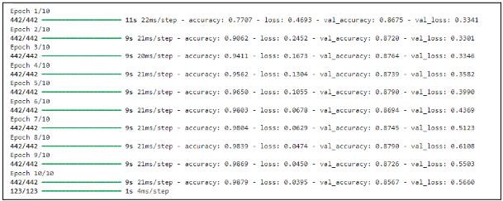
Deliver - LSTM Model Training (7)
LSTM Model Training Progress
This graph illustrates the training progress of the LSTM model, showing the changes in accuracy and loss over the epochs.
Key Findings:
Improving Accuracy: Model learned from data over time.
Decreasing Loss: Model minimized errors.
Overfitting Potential: Evidence of overfitting.
Implications:
High training accuracy but potential overfitting.
Explore early stopping or regularization.
Notes:
This graph illustrates how the model's accuracy and loss changed during training.
Key Findings:
Improving Accuracy: The model learned from the data over time, resulting in higher accuracy.
Decreasing Loss: The model minimized errors as training progressed.
Overfitting Potential: There are signs of overfitting, which means the model might be memorizing the training data too well and not generalizing well to new data.
Implications:
The high training accuracy is promising, but the potential for overfitting needs to be addressed.
Techniques like early stopping or regularization can help prevent overfitting and improve the model's generalization performance.
By analyzing this training progress, we can gain insights into the model's behavior and identify areas for optimization.

Slide 22
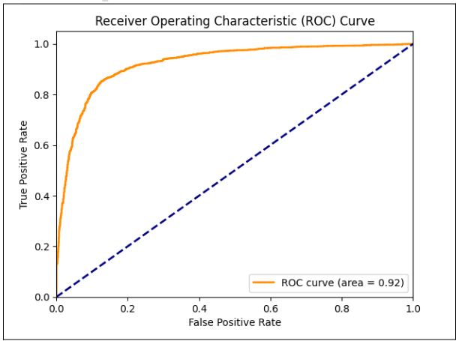
Deliver - LSTM Model Training (7)
Evaluation Metrics - ROC AUC Score
This ROC curve illustrates the performance of the LSTM model in distinguishing between stress and non-stress posts.
Key Findings:
AUC-ROC Score: 0.92, indicating strong overall performance.
Curve Shape: Upward-sloping curve, suggesting good discrimination ability.
Implications:
Effective model for stress detection.
Threshold selection for desired balance between sensitivity and specificity.
Notes:
This ROC curve illustrates the performance of the LSTM model in distinguishing between stress and non-stress posts.
Key Findings:
AUC-ROC Score: 0.92, indicating strong overall performance. This means the model is effective at separating stress and non-stress posts.
Curve Shape: The upward-sloping curve suggests good discrimination ability. This indicates that the model can effectively distinguish between the two classes across different thresholds.
Implications:
The high AUC-ROC score demonstrates that the LSTM model is an effective tool for stress detection.
To achieve the desired balance between sensitivity and specificity, you can select an appropriate threshold based on the specific requirements of your application.
By analyzing this ROC curve, we can gain further insights into the model's performance and make informed decisions regarding its deployment.

Slide 23
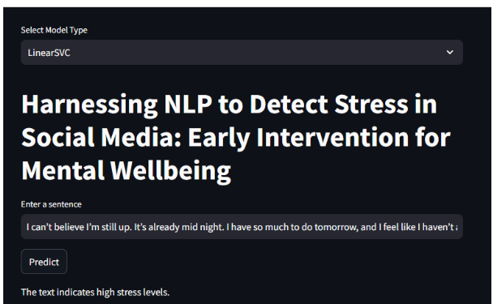
Deliver (8)
Deployment - Stress Detection Web Application (Stress)
Sample sentence: “I can’t believe I’m still up. It’s already midnight. I have so much to do tomorrow, and I feel like I haven’t accomplished anything today. My head is spinning, and I can’t seem to focus. I just want to crawl into bed and disappear. I’m so tired and overwhelmed. I don’t know how I’m going to make it through this week.”
Steamlit:
V1.0: https://socialmediastressdetection-7fzrqotzmpuwlwrcq82kpa.streamlit.app/
V0.2 (test): https://socialmediastressdetection-3rrnmlwq4coze4fgihuiq8.streamlit.app/
Notes:
This web application allows users to enter a sentence and receive a prediction about the level of stress expressed in the text.
Sample Sentence: "I can't believe I'm still up. It's already midnight. I have so much to do tomorrow, and I feel like I haven't accomplished anything today. My head is spinning, and I can't seem to focus. I just want to crawl into bed and disappear. I'm so tired and overwhelmed. I don't know how I'm going to make it through this week."
When this sentence is entered into the application, the model predicts high stress levels. This demonstrates the model's ability to accurately detect stress in text.
By deploying this web application, we can make our stress detection model accessible to a wider audience and potentially provide valuable insights for individuals struggling with mental health challenges.

Slide 24
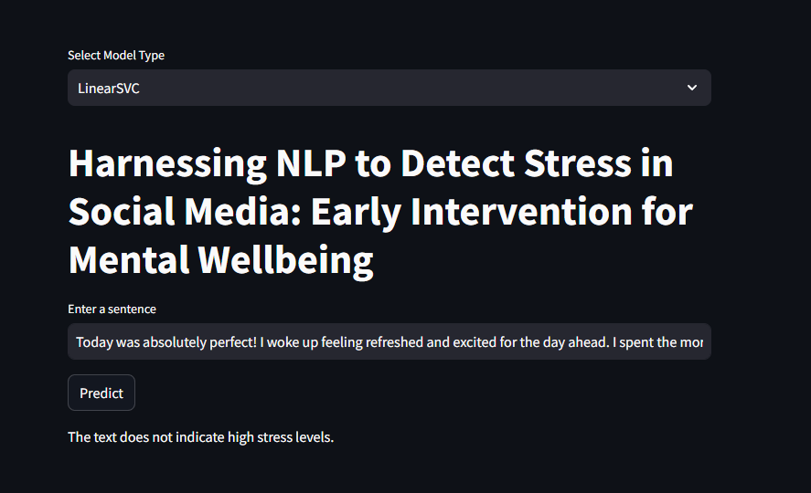
Deliver (9)
Deployment - Stress Detection Web Application (Non - Stress)
Sample sentence: “Today was absolutely perfect! I woke up feeling refreshed and excited for the day ahead. I spent the morning enjoying a leisurely breakfast with my loved ones, followed by a long walk in the park. The sun was shining, the birds were singing, and I couldn't help but smile. I felt a sense of peace and contentment that I haven't experienced in a long time. It's truly amazing how a simple day filled with gratitude and joy can make such a difference.”
Steamlit:
V1.0: https://socialmediastressdetection-7fzrqotzmpuwlwrcq82kpa.streamlit.app/
V0.2 (test): https://socialmediastressdetection-3rrnmlwq4coze4fgihuiq8.streamlit.app/
Notes:
This slide demonstrates how the application handles a non-stressful sentence.
Sample Sentence: "Today was absolutely perfect! I woke up feeling refreshed and excited for the day ahead. I spent the morning enjoying a leisurely breakfast with my loved ones, followed by a long walk in the park. The sun was shining, the birds were singing, and I couldn't help but smile. I felt a sense of peace and contentment that I haven't experienced in a long time. It's truly amazing how a simple day filled with gratitude and joy can make such a difference."
When this sentence is entered into the application, the model correctly predicts low stress levels. This demonstrates the model's ability to accurately identify non-stressful text.
By testing the application with both stressful and non-stressful sentences, we can validate its effectiveness in detecting stress across different scenarios.

Slide 25
Summary
Stress Detection Model: Developed a successful NLP-based model to detect stress in social media text.
Model Performance: Achieved high accuracy and F1-score, demonstrating strong performance in classifying stress and non-stress posts.
Class Imbalance: Addressed the class imbalance issue through techniques like class weighting or oversampling.
Future Directions: Considered potential improvements and future research directions.
Notes:
Stress Detection Model: successfully developed an NLP-based model to detect stress in social media text. This model leverages the power of natural language processing to identify patterns and cues associated with stress.
Model Performance: The model achieved high accuracy and F1-score, demonstrating strong performance in classifying stress and non-stress posts. This indicates that the model is effective in detecting stress accurately.
Class Imbalance: addressed the class imbalance issue in our dataset, which can affect model performance. Techniques like class weighting or oversampling were employed to mitigate the impact of this imbalance.
Future Directions: While the model shows promising results, there are areas for further improvement. Potential future research directions include exploring different NLP techniques, expanding the dataset, and refining the model's ability to handle different language styles and dialects.

Slide 26
Conclusions
Accurate Stress Detection: Developed a model capable of accurately detecting stress in social media text.
Valuable Insights: Gained insights into the linguistic patterns associated with stress and non-stress.
Potential for Early Intervention: The model can be used for early identification of individuals at risk of stress.
Notes:
Accurate Stress Detection: successfully developed a model capable of accurately detecting stress in social media text. This demonstrates the model's effectiveness in identifying individuals who may be struggling.
Valuable Insights: This project provided valuable insights into the linguistic patterns associated with stress and non-stress. These findings can contribute to a deeper understanding of how language reflects emotional states.
Potential for Early Intervention: The model can be used for early identification of individuals at risk of stress. This has significant implications for mental health support and intervention, as early detection can lead to more effective interventions.

Slide 27
Next Steps
Deployment: Integrate the model into a real-world application (e.g., social media platform, mental health platform).
Data Collection: Collect more diverse and representative data to improve model generalizability.
Model Refinement: Explore advanced techniques like transfer learning or ensemble methods to further enhance performance.
Ethical Considerations: Address ethical implications of using AI for mental health detection and ensure privacy and fairness.
Overall, this project demonstrates the potential of NLP-based approaches for early stress detection and highlights the importance of addressing ethical considerations in AI for mental health.
Notes:
Deployment: The developed model can be integrated into a real-world application, such as a social media platform or a mental health platform. This would allow for the practical application of the model and its potential benefits in early stress detection.
Data Collection: To further improve the model's generalizability, it's important to collect more diverse and representative data. This would help the model better understand and detect stress in different contexts and populations.
Model Refinement: Advanced techniques like transfer learning or ensemble methods can be explored to enhance the model's performance. These techniques can help the model learn from existing knowledge and improve its accuracy.
Ethical Considerations: It's crucial to address the ethical implications of using AI for mental health detection. This includes ensuring privacy, fairness, and avoiding unintended biases in the model's predictions.
Overall, this project demonstrates the potential of NLP-based approaches for early stress detection. However, it's important to continue addressing ethical considerations and exploring ways to improve the model's performance and generalizability.

Slide 28
Appendices

Slide 29
References
Data Source: https://www.kaggle.com/datasets/mexwell/stress-detection-from-social-media-articles
Source Code:
https://github.com/jimmychong1983/SocialMediaStressDetection
Steamlit:
V1.0: https://socialmediastressdetection-7fzrqotzmpuwlwrcq82kpa.streamlit.app/
V0.2 (test): https://socialmediastressdetection-3rrnmlwq4coze4fgihuiq8.streamlit.app/
Notes:
Source: Kaggle Dataset
Objective: Develop a more accurate and efficient NLP-based approach to automatically detect stress in social media text, enabling early intervention and improved mental health support.
Datasets:
We constructed four high-quality datasets using text articles from Reddit and Twitter.
Each article is labeled with a class value of '0' (Stress Negative) or '1' (Stress Positive).
Annotations were done using an automated DNN-based strategy.
Dataset Descriptions:
Reddit Combi: This dataset combines title and body text from stress and non-stress related subreddits.
Reddit Title: This dataset consists of titles from stress and non-stress related subreddits.
Twitter Full: This dataset contains stress and non-stress related tweets.
Twitter Non-Advert: This dataset is a denoised version of Twitter Full, removing potential advertisements.
Data Exploration:
We explored the data using Python libraries like pandas to understand the number of rows, column names, and data types.
We examined the first few rows of each DataFrame to get a sense of the content and labels.
We checked for missing values and handled them by dropping rows with missing entries (dropna).
We preprocessed the data:
Dropped unnecessary columns (Reddit Combi).
Cleaned hashtags in Twitter data using regular expressions.
Concatenated all preprocessed DataFrames into a single one.
We analyzed the data distribution:
Visualized the distribution of stress labels using a bar chart.
Examined the distribution of text length for stress and non-stress articles using a histogram.
Generated word clouds to visualize frequently used words in stress and non-stress articles.
Data Split:
We split the data into features (title) and target (stress label).
We further split the data into training (80%) and testing (20%) sets for model evaluation.

Slide 30
Questions

Slide 31
Thank you
End of Presentation

